Slide 1
Challenges
Mini challenge 2

Slide 2
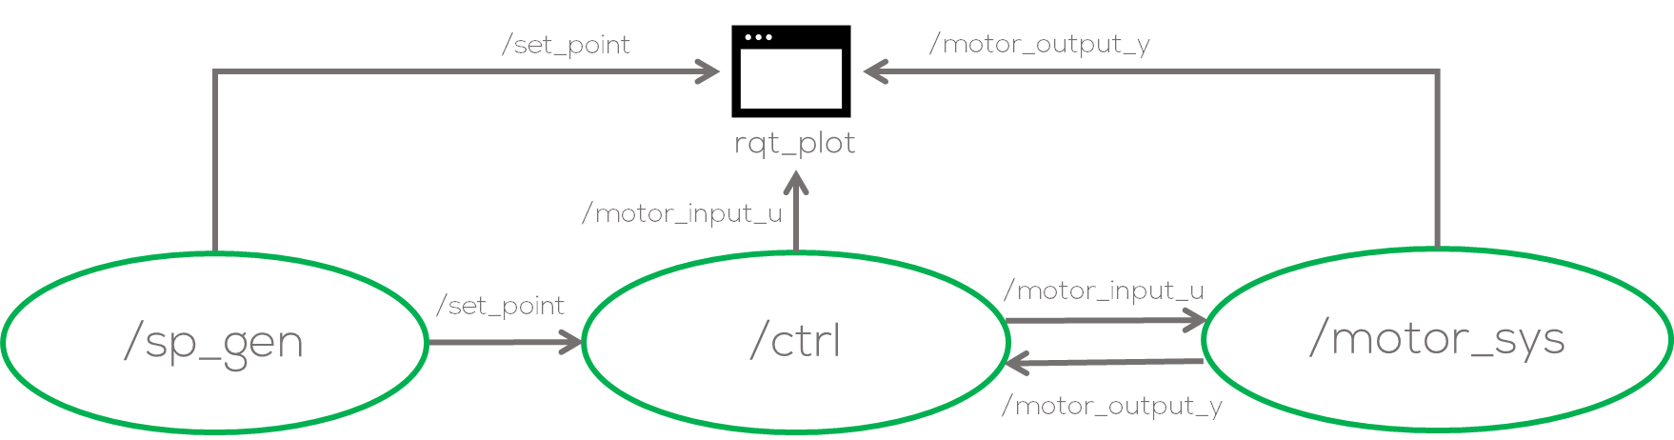
Mini Challenge 2
Introduction
This mini-challenge is intended for the student to review the concepts introduced in the previous sessions.
The activity involves creating a controller for ROS’s simulated DC motor (/motor_sys) Used during Activity 3.
The “/motor_sys” node, and a “/sp_gen” simple program structure (not mandatory) are provided by MCR2.
The controller can be “P”, “PI” or “PID” controller (other controllers can be accepted upon agreement with the professor.).

Slide 3
Mini Challenge 2
Instructions
Download the package “motor_control” from the mini-challenge folder. You can use the package developed during the class just be CAREFUL with the Topics of the sp_node.
Save and compile the file
Launch the node
Open the rqt_graph and rqt_plot
Publish a message to test that everything is working
If using the template, the nodes should appear disconnected. If using the package form the class activity the nodes will be connected via the the “motor_input_u” topic. CHANGE IT!! To control it to the controller.
$ ros2 run rqt_graph rqt_graph
$ ros2 run rqt_plot rqt_plot
$ ros2 topic pub /motor_input_u std_msgs/msg/Float32 "data: 5.0"
$ cd ~/ros2_ws
$ colcon build
$ source install/setup.bash
$ ros2 launch motor_control motor_launch.py

Slide 4
Mini Challenge 2
Instructions
In this challenge the student must generate a new node called “controller”
The student must make all the changes necessary to the package to generate the feedback structure.
The node must subscribe to the “set_point” node and publish to the “motor_node”.
If using your nodes from the class activity, modify the “set_point” node to change the topic from “motor_input_u” to “set_point”
If using the template, this is already done for you.

Slide 5
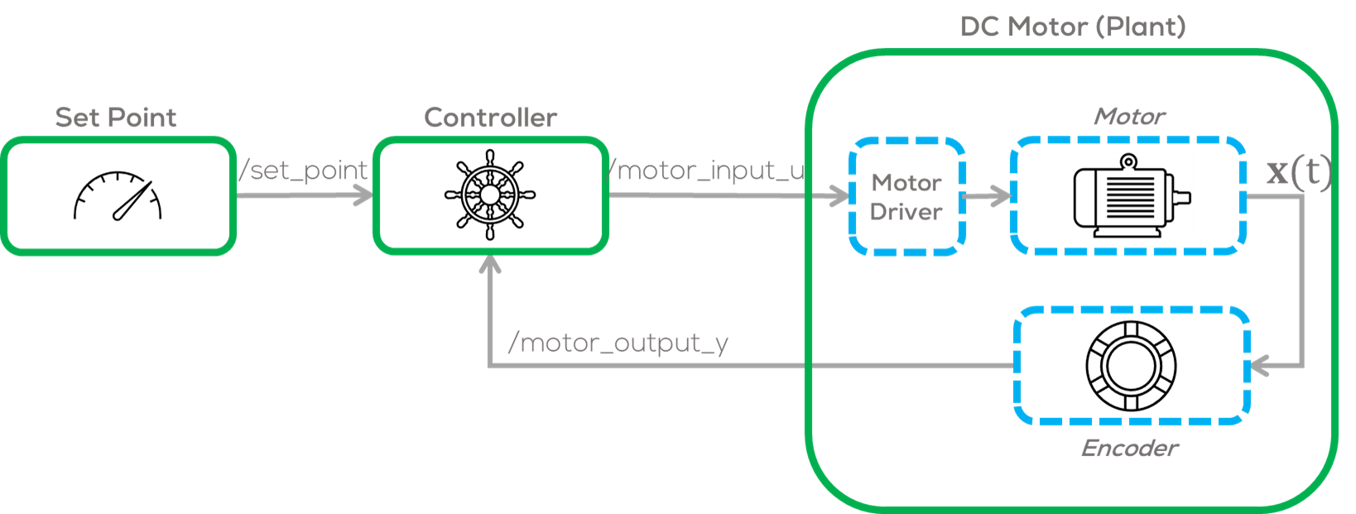
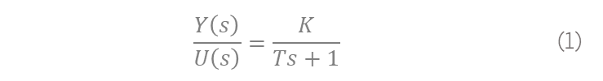
Mini Challenge 2
motor_sys node
The “process node” is a node made by MCR2, that simulates a first order system of the form
Approximating a simple DC Motor with a motor driver and an encoder.
The input and output of the node are simple messages Float32.
The student must use these messages to communicate with the system.
$$\frac{Y\left(s\right)}{U\left(s\right)}=\frac{K}{Ts+1}$$ | (1)

Slide 6
Mini Challenge 2
motor_sys node
The system parameters can be set from a launch file “motor_launch”
The node’s parameters are based on Eq. 1.
It is suggested that for this exercise the parameters remain unchanged.
Hints
It is encouraged to analyse the system before using it with the controller.
Sending different input signals to verify its behaviour.
The system can be tested by using ROS command line tools as follows.
'sample_time': 0.01, #System Sample time
'sys_gain_K': 2.16, #Gain parameter K
'sys_tau_T': 0.05, #Time constant parameter T
'initial_conditions': 0.0, #System’s Sample time
$ ros2 topic pub /motor_input_u std_msgs/msg/Float32 "data: 5.0"

Slide 7
Mini Challenge 2
The sampling time and rate can be the same as the “/system” node.
It is strictly forbidden to use any other python library, other than NumPy. The controller must be made without using any predefined online controllers.
Controller Node
Make a node called “/ctrl” to generate a control input to the “/motor_sys” node.
The node must publish in the “/motor_input_u” topic and subscribe to the “/motor_output_y” and “/set_point” topics.
The control node parameters must be set in the launch file or as a config file (YAML).
The user must be able to tune the parameter at runtime, and if a parameter is incorrect, the node must let the user know.

Slide 8
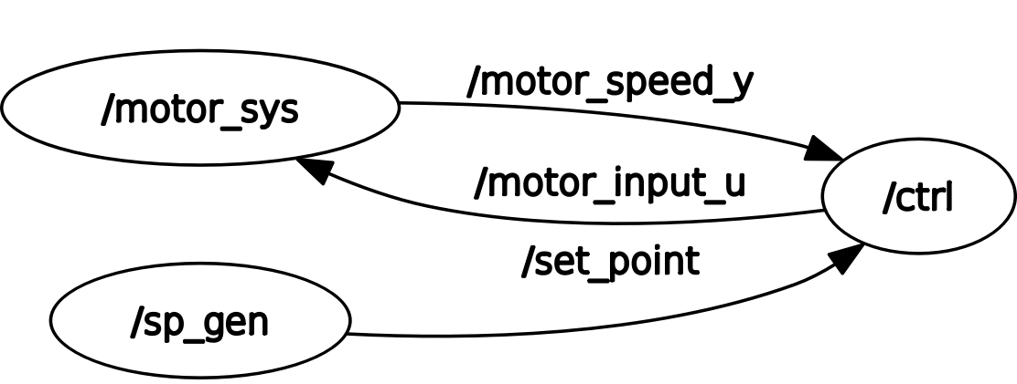
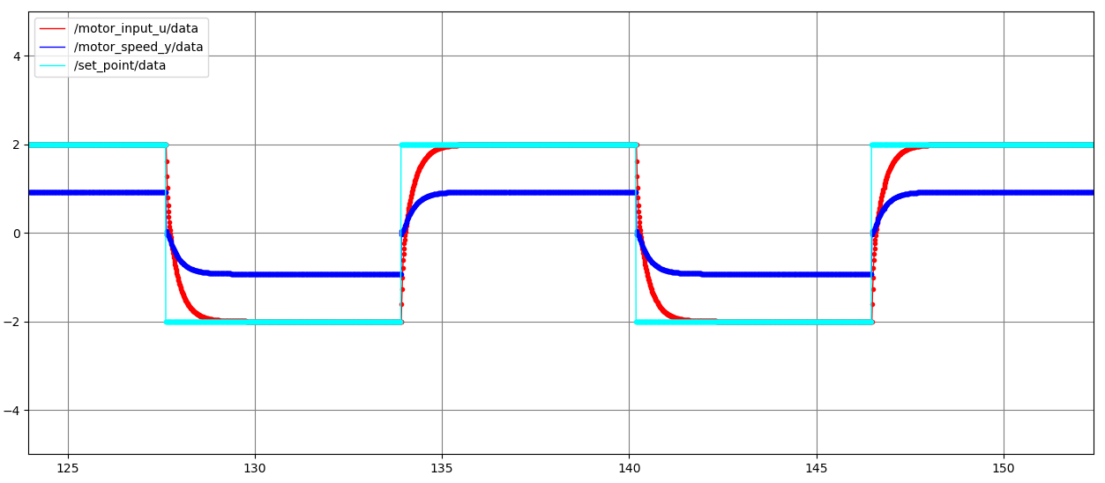
Mini Challenge 2
Launch File
Make or modify a Launch file that opens and runs the three nodes continuously.
The parameters of the three nodes must be set in the launch file.
Use the rqt_plot and rqt_graphs to visualise the results.
Use the rqt_reconfigure to modify the parameters at runtime.
Expected Results

Slide 9
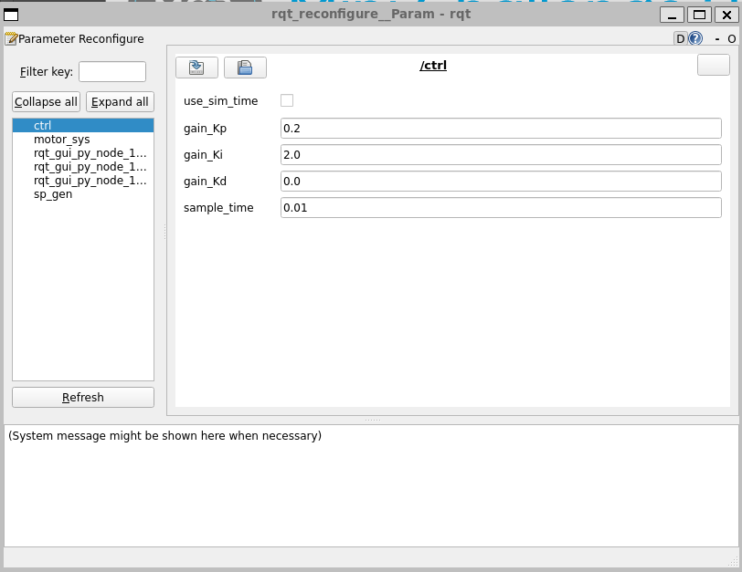
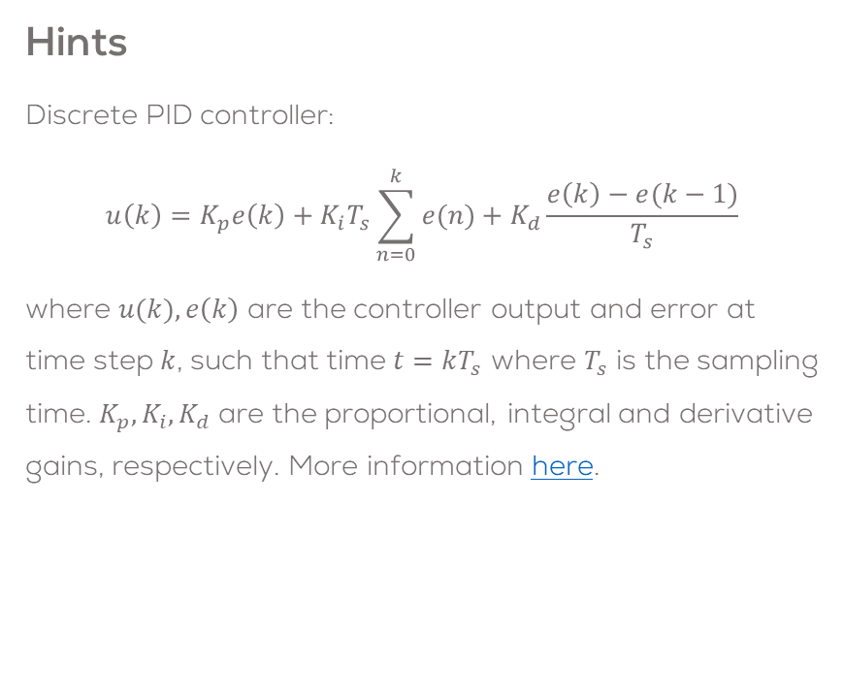
Mini Challenge 2
Use rqt_reconfigure to modify the parameters at runtime and tune the PID controller.
Hints
Discrete PID controller:
$$u\left(k\right)=K_{p}e\left(k\right)+K_{i}T_{s}\sum_{n=0}^{k}{e(n)}+K_{d}\frac{e\left(k\right)−e(k−1)}{T_{s}}$$
where $u(k),e\left(k\right)$ are the controller output and error at time step $k$, such that time $t=kT_{s}$ where $T_{s}$ is the sampling time. $K_{p}, K_{i}, K_{d}$ are the proportional, integral and derivative gains, respectively. More information here.
$ ros2 run rqt_reconfigure rqt_reconfigure

Slide 10
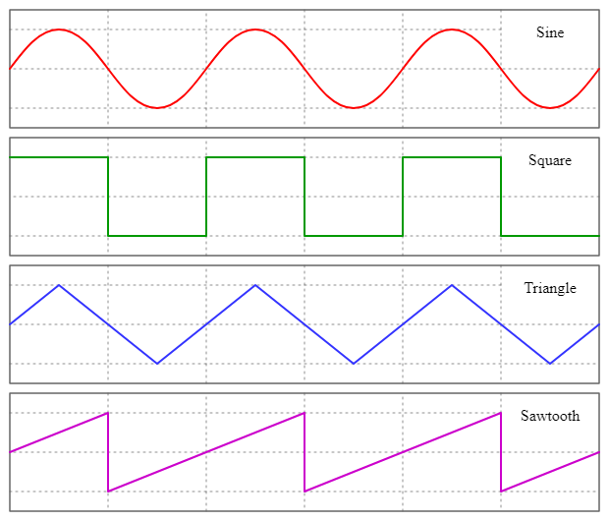
Mini Challenge 2 (Extension)
Instructions
Use and modify the “/sp_gen” node to generate different set point signals.
The set point generator can be a sinusoidal signal, square signal, etc.
The user must be able to set the type of signal at runtime must set the type of signals.
Set a parameter in charge of this change.
As before, It is forbidden to use any libraries, except from NumPy, for this exercise.
Make the necessary plots to analyse the system in rqt_plot

Slide 11
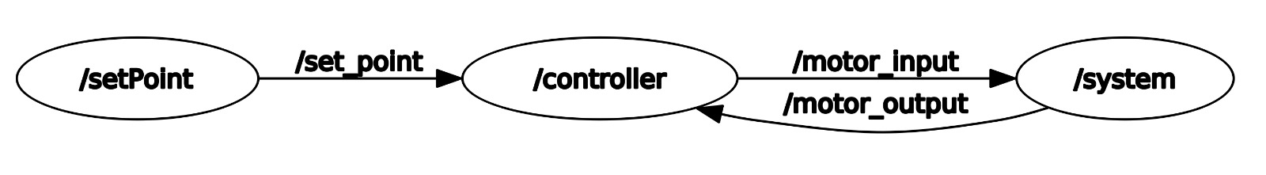
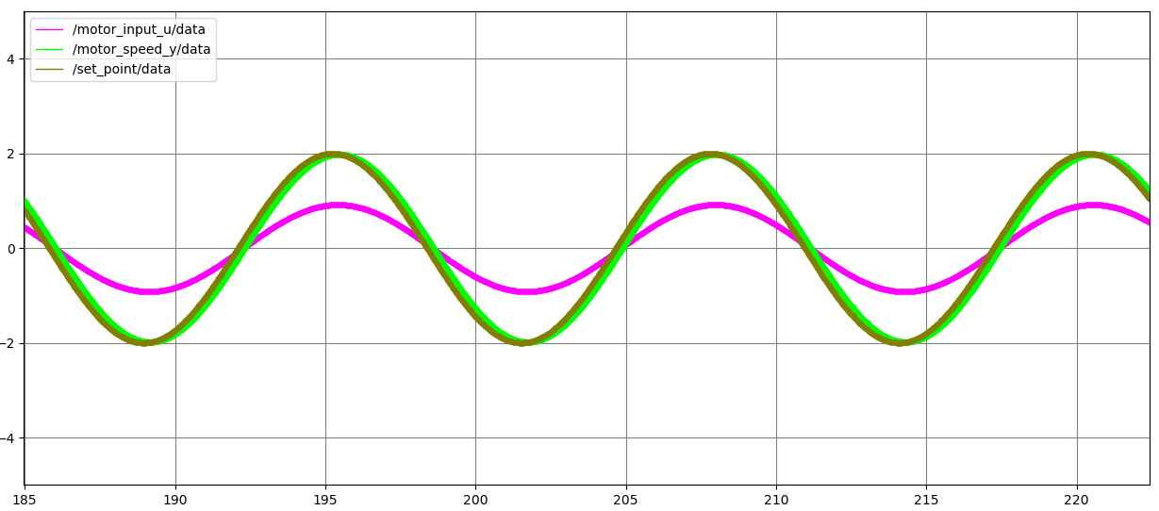
Mini Challenge 2 (Extension)
Expected results
Nodes used for this exercise

Slide 12
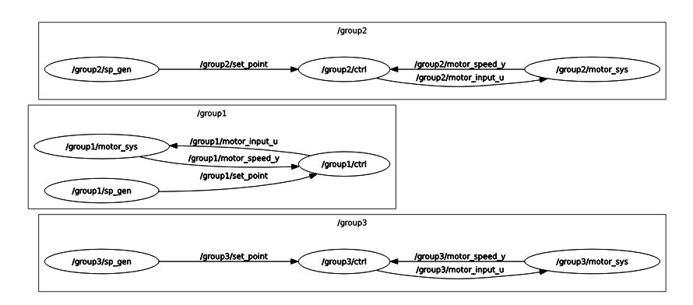
Mini Challenge 2 (Extension)
Instructions
Make a new Launch called “challenge_launch.py” file to generate three motor control groups.
Use namespaces to verify that the data is sent to the appropriate nodes.
Namespaces should be “group1”, “group2” and “group3”

Slide 13
Mini Challenge 2 (Extra)
Instructions
Use services to start and stop the “motor_sys” and the “ctrl” nodes.
You can activate the nodes however you want, i.e., in the constructor of the “sp_gen” or using the keyboard so that the user presses a key or writes a word to start activating all the nodes.
This part of the exercise is not mandatory but will help you practice the concept of services.

Slide 14
Rules
This is challenge not a class. The students are encouraged to research, improve tune explain their algorithms by themselves.
MCR2(Manchester Robotics) Reserves the right to answer a question if it is determined that the questions contains partially or totally an answer.
The students are welcomed to ask only about the theoretical aspect of the classed.
No remote control or any other form of human interaction with the simulator or ROS is allowed (except at the start when launching the files).
It is forbidden to use any other internet libraires with the exception of standard libraires or NumPy.
If in doubt about libraires please ask any teaching assistant.
Improvements to the algorithms are encouraged and may be used as long as the students provide the reasons and a detailed explanation on the improvements.
All the students must be respectful towards each other and abide by the previously defined rules.
Manchester Robotics reserves the right to provide any form of grading. Grading and grading methodology are done by the professor in charge of the unit.

